Slide 1


Slide 2
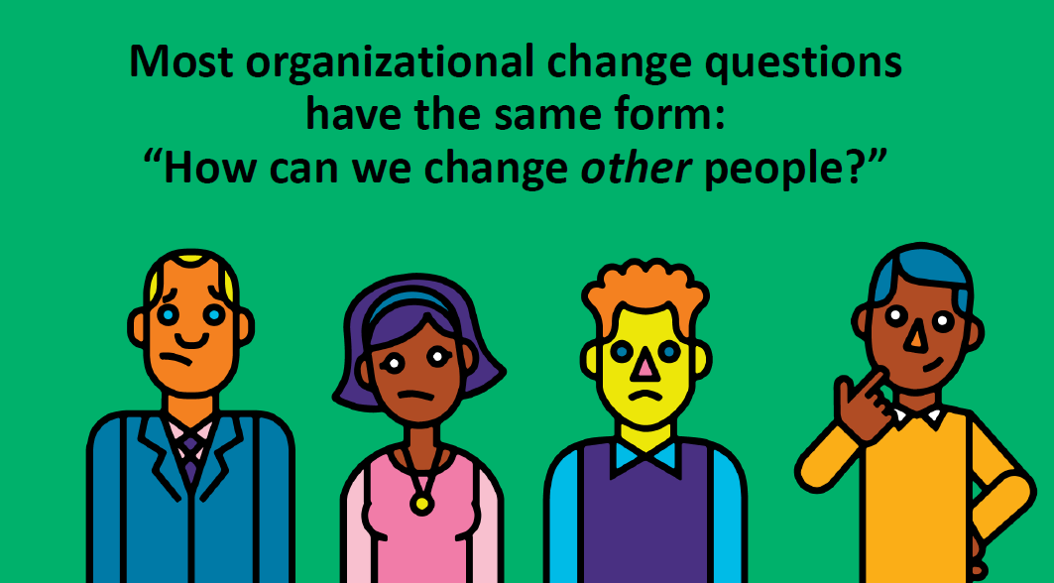


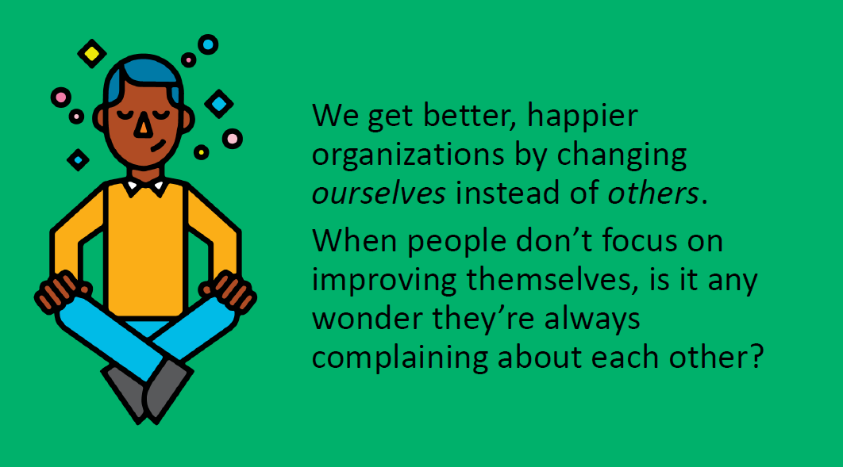

Slide 3
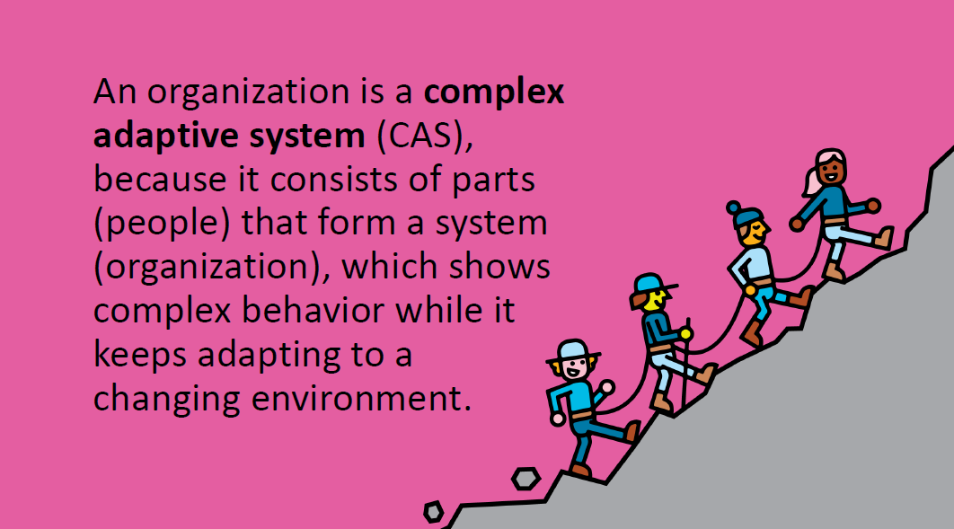
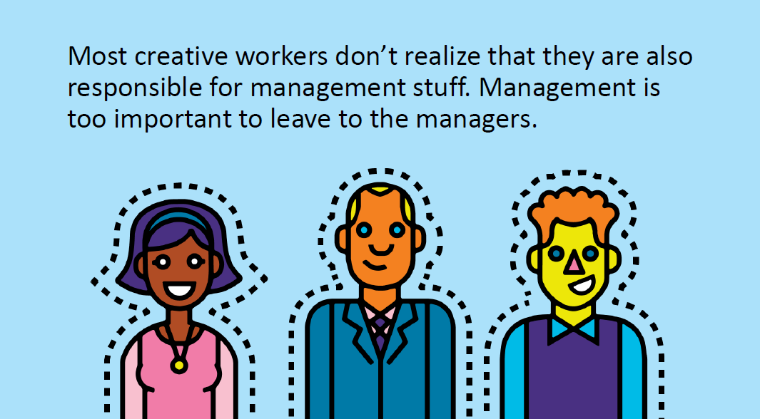
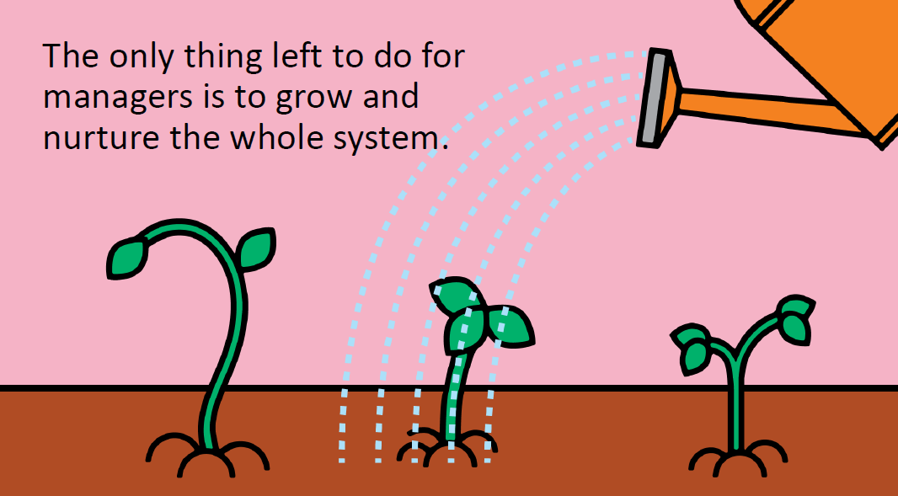

Slide 4


Slide 6
Notes:
CHAMPFROGS
Curiosity
Honor
Acceptance
Mastery
Power
Freedom
Relatedness
Order
Goal
Status

Slide 18
source: © 2014 Zappos, “2014 Culture Book” http://www.zapposinsights.com/culture-book

Slide 19
source: © 2014 Zappos, “2014 Culture Book” http://www.zapposinsights.com/culture-book

Slide 20
source: © 2013 IDEO, “The Little Book of IDEO” http://www.slideshare.net/timbrown/ideo-values-slideshare1

Slide 21
source: © 2013 IDEO, “The Little Book of IDEO” http://www.slideshare.net/timbrown/ideo-values-slideshare1

Slide 46
Business Guilds & Communities of Practice
Celebration Grid
Copilot Programs
Competency Matrix
Corporate Huddles
Culture Books
Delegation Board
Exploration Days
Feedback Wraps
Happiness Door
Identity Symbols
Improvement Dialogues
Improv Cards & Storytelling
Internal Crowdfunding
Kudo Box
Meddlers
Merit Money
Metrics Ecosystem
Moving Motivators & CHAMPFROGS
OKRs (Objectives & Key Results)
Personal Maps
Project Credits
Problem Time
STAR Behavioral Recruitment Questions
12 Steps to Happiness
Salary Formula
Scoreboard Index
Unlimited Vacations
Value Stories
Visual Goal Setting
Work Expos
Work Profiles
Yay! Questions

